Slide 1
SC-400T00A Microsoft Information Protection and Compliance Administrator
Author name

Slide 2
Implement Information Protection in Microsoft Purview

Slide 3
Outline
Introduction to information protection in Microsoft Purview
Classify data for protection and governance
Create and manage sensitive information types
Describe Microsoft 365 encryption
Deploy message encryption in Microsoft Purview
Protect information in Microsoft Purview
Apply and manage sensitivity labels

Slide 4
Introduction to information protection in Microsoft Purview

Slide 5
Agenda: Introduction to information protection in Microsoft Purview
Discuss information protection and data lifecycle management and why it’s important.
Describe Microsoft’s approach to information protection and data lifecycle management.
Define key terms associated with Microsoft’s information protection and data lifecycle management solutions.
Identify the solutions that comprise information and data lifecycle management in Microsoft 365.

Slide 6
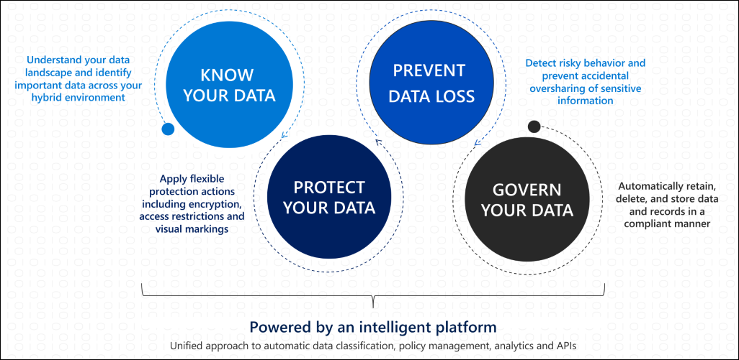
Introduction to information protection
Notes:
Supporting videos for instructor or student use:
Information Protection in Microsoft 365
https://youtu.be/UI0p9xqMNfI?list=PLXtHYVsvn_b8dbRbnL19GUPcBH1UQ7c4x
(7 minutes)

Slide 7
Know your data
Data classification concepts, apply one or more of the following to your data:
Sensitive information types
Trainable classifiers
Labels
Policies

Slide 8
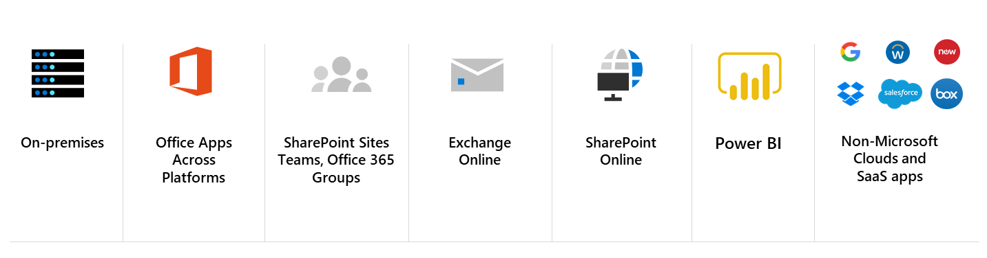
Protect your data
Information protection is integrated into Microsoft 365 apps and services like:

Slide 9
Prevent data loss
Secure Data
Enable productivity
Enforce conditional access to sensitive data
DLP action to block sharing
Encrypt files and emails based on sensitivity label
Prevent data leakage through DLP policies based on sensitivity label
Business data separation on devices
Secure email with encryption & permissions
Manually apply sensitivity label consistently across applications and endpoints
Show recommendations and tooltips for sensitivity labels with auto-labeling and DLP
Visual markings to indicate sensitive documents across apps and services (like watermarks, lock icons, sensitivity column in SharePoint Online)
Co-author and collaborate with sensitive documents
Enable searching of encrypted files in SharePoint
Allow users to open and share encrypted PDF files in Edge in addition to Adobe Acrobat Reader

Slide 10
Govern your data
Themes of the Microsoft solutions for governing your data:
Streamlined administration
Automation at scale
Tailored workflows

Slide 11
Classify data for protection and governance

Slide 12
Agenda: Classify data for protection and governance
List the components of the data classification solution.
Identify the cards available on the Data Classification overview tab.
Explain the Content explorer and Activity explorer.

Slide 13
Data classification overview
Microsoft 365 data classification components:
Overview
Content explorer
Activity explorer
Sensitive info types
Trainable classifiers
Provides snapshots of how sensitive information types and labels are being used.
Explore the email and documents in your organization that contain sensitive information or have labels applied.
Review activity related to content containing sensitive info or has labels applied, such as what labels were changed, files were modified, and more.
Manage the built-in and custom sensitive information types available to classify data.
Manage the classifiers used to identify content based on what the item is, not by the elements in the item.
Notes:
Data classification in the Microsoft Purview compliance portal
https://www.microsoft.com/en-us/videoplayer/embed/RE4vx8x?postJsllMsg=true
(4 minutes)

Slide 14
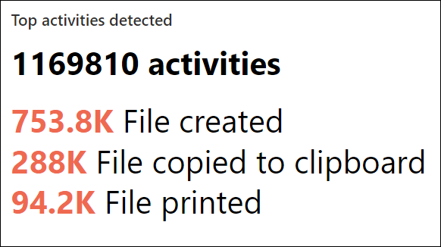
Review sensitive information and label usage
The Overview page can answer questions like:
What sensitive data is out there?
What labels are being used the most?
Is sensitive data being copied or shared outside the organization?

Slide 15
Classify data using sensitive information types
Information protection and governance solutions and where in those solutions you can use sensitive information types:
Information protection: Sensitivity label auto-labeling policies
Data loss prevention (DLP): DLP policies
Data Lifecycle Management: Retention policies and retention label auto-apply policies
Records management: Retention label auto-apply policies
Notes:
Sensitive information types explained:
https://www.microsoft.com/en-us/videoplayer/embed/RE4Hx60

Slide 16
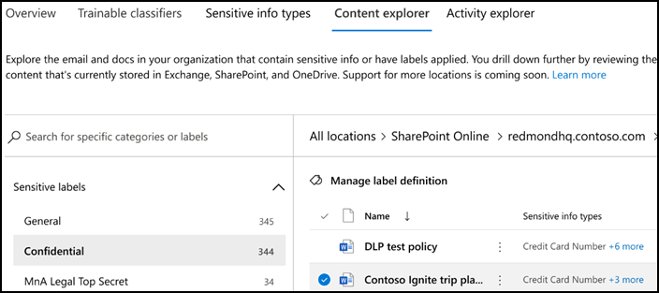
Explore labeled and sensitive content
Here is a summary of what the content explorer provides:
Visibility into the amount of sensitive data in a document that triggered the classification to be applied.
Ability to filter by label or sensitive information type to get a detailed view of the locations where the data is stored.
Integrated viewer to display documents, providing context for the circumstances in which sensitive information is being detected.

Slide 17
Activities related to your data
Activity explorer provides the following:
Visibility into document-level activities like label changes and label downgrades.
Ability to filter to see all the details for a specific label including file types, users, and activities.
Understand a broad-spectrum of sensitivity label activities across Microsoft 365.
Notes:
Supporting videos for instructor or student use:
Demonstration: Data classification features in the Compliance center
https://www.microsoft.com/videoplayer/embed/RE4vx8x
(5 minutes)

Slide 18
Create and manage sensitive information types

Slide 19
Agenda: Create and manage sensitive information types
Recognize the difference between built-in and custom sensitive information types.
Configure sensitive information types with exact data match-based classification.
Implement document fingerprinting.
Create custom keyword dictionaries.

Slide 20
Compare built-in versus custom sensitive information types
Built-in sensitive information types
Custom sensitive information types
More than 260 built-in sensitive information types.
Includes default patterns managed by Microsoft.
Fulfills basic protection of common information types.
Starting point for implementations.
Allows to detect business individual sensitive information.
Consists of customized patterns.
Provides several special features:
Exact Data Match (EDM)-based classification
Document Fingerprinting
Keyword dictionaries

Slide 21
Create and manage custom sensitive information types
Sensitive information type parts:
Primary pattern
Search pattern for detection, consisting of keywords or regular expressions.
Additional evidence
Second search pattern for higher matching accuracy of the primary pattern, consists of keywords.
Character proximity
Detection window in characters of primary patterns and additional evidence.
Confidence level
Supporting level of pattern and evidence matching accuracy.

Slide 22
Create a keyword dictionary
Efficient way to manage large lists of words that are regularly subject to changes
Supports up to 1mb of terms after compression.
Source can be cleartext files such as .txt and .csv files.
Keyword Dictionary Creation Best Practices:
For a school, get together with a class of students to find words and phrases you don’t want in an education environment.
For companies, use various options to collect keywords:
Search typical words from some departments e.g., using Microsoft Forms.
Information from employees e.g., from HR or legal to create a list of typical words.
Create an employee audit and then create the list out of the outcome.
Notes:
Instructor notes:
Link to create a Keyword dictionary
https://docs.microsoft.com/en-us/microsoft-365/compliance/create-a-keyword-dictionary?view=o365-worldwide

Slide 23
Describe custom sensitive information types with exact data match
Sensitive information type based on database matching
Phase | Requirements
Step 1: Set up EDM-based classification | Read access to the sensitive data Database schema in XML format Rule package in XML format Admin permissions to the Security & Compliance Center
Step 2: Hash and upload the sensitive data | Custom security group and user account Local admin access to machine with EDM Upload Agent Read access to the sensitive data Process and schedule for refreshing the data
Step 3: Use EDM-based classification in policies | Microsoft 365 subscription with DLP EDM-based classification feature enabled
Supports up to 100 million rows of sensitive data, 32 columns (fields) per data source and up to 5 columns (fields) marked as searchable.
Additional license requirements.
Configuration done in three steps:
Step 1: Set up EDM-based classification
Step 2: Hash and upload the sensitive data
Step 3: Use EDM-based classification in policies

Slide 24
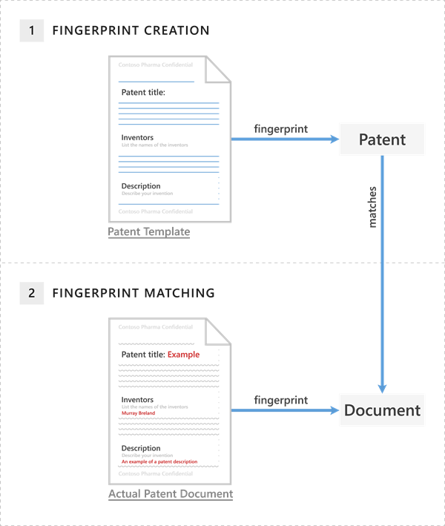
Implement document fingerprinting
Digital fingerprint from empty template document.
Detection of documents created from a template.
Requires all fields from the original template document.
Exchange Online only.
Password protected files are not supported, as well as documents containing images.
Notes:
Instructor note:
You can currently create a document fingerprint only by using PowerShell.
Link to scenarios and process for document fingerprinting:
https://docs.microsoft.com/microsoft-365/compliance/document-fingerprinting?view=o365-worldwide

Slide 25
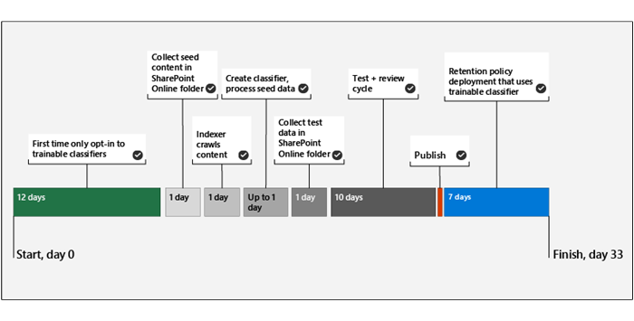
Classify data using trainable classifiers
Training includes several steps:
Items of a type added to a SharePoint library.
Train until the classifiers do not request additional training documents.
Review items to improve the classifier accuracy.
Notes:
Supporting videos for instructor or student use:
Demonstration: Trainable classifiers
https://www.microsoft.com/videoplayer/embed/RE4yg7t
(4 minutes)

Slide 26
Classify data using trainable classifiers (continued)
Classifiers separate into default classifiers, custom trainable classifiers, and retrained classifiers.
Built-in or default classifiers
Classification for basic use or testing: Offensive Language, Resumes, Source Code, Targeted Harassment, Profanity and Threat.
Custom classifiers
Must be activated, which requires 7-14 days for basic analytics.
Training requires 50-500 positive samples of seed data.
Up to 24 hours of seed data top be processed.
Up to 10,000 positive and negative samples for testing.

Slide 27
When to use trainable classifiers versus sensitive information types
Sensitive information types match specific types of data according to their schemes
Trainable classifiers look for exact matches they are trained via machine learning algorithms
Both features require E5 licensing plans
Comparison | Sensitive information types | Trainable classifier
Detecting | Scheme | Algorithm/machine learning
Detecting content | Information in items matching the scheme | Files, emails, information, Teams Chats with similar information to the training documents
Custom | Yes, via programming | Yes, via training
Examples | Credit Card, IP Address, Azure Keys | Invoices, Offensive language, Tread harassment, Employee Agreements, NDA Forms
Notes:
Optional slide if you decide to present more on trainable classifiers

Slide 28
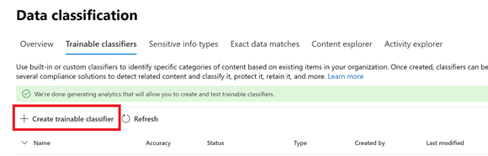
Train a custom trainable classifier
Training the algorithm to detect files.
Libraries for training the classifier should not include unwanted documents not relevant for the trained classifier.
Multiple types of information require multiple trainable classifiers.
Training requires approximately 1 hour for every 1000 items.
After publishing, the trainable classifier can be used in sensitivity labels or retention labels.
Notes:
Optional slide if you decide to present more on trainable classifiers

Slide 29
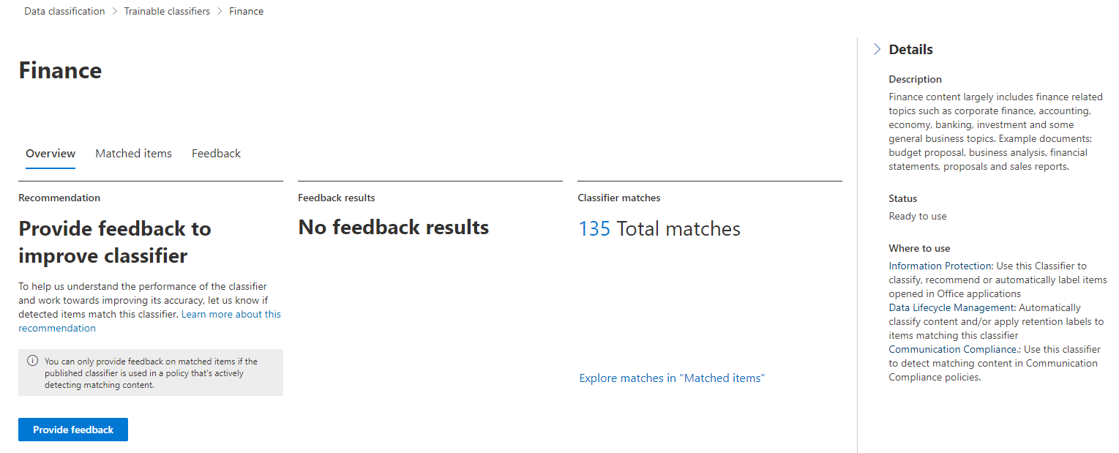
Verify a trainable classifier is performing properly
Trainable classifiers need to be monitored to determine if they work as expected.
Some additional indicators for its performance are:
True and false positives
Low number of matches
No matches
A very long time for a match
Any of these can indicate, that a refinement of the item base and a retraining of the classifier is required to make it work as expected.
Notes:
Optional slide if you decide to present more on trainable classifiers

Slide 30
Guided demonstration – protect sensitive data
Scenario:
You are the compliance administrator tasked with apply sensitive data controls and investigating suspicious activity.
Task 1
Detect sensitive information
Task 2
Apply controls
Task 3
Investigate suspicious activities
Notes:
This recorded demo is provided to give learners a sense of the experience when a user sends and receives a protected message.
Follow the annotations and advice for where to click.
Time required: 25 minutes
Guided demo link: https://aka.ms/AAbfsel

Slide 31
Describe Microsoft 365 encryption

Slide 32
Agenda: Describe Microsoft 365 encryption
Explain how encryption mitigates the risk of unauthorized data disclosure.
Describe Microsoft data-at-rest and data-in-transit encryption solutions.
Explain how Microsoft 365 implements service encryption to protect customer data at the application layer.
Describe the differences between Microsoft managed keys and customer managed keys for use with service encryption.

Slide 33
Introduction to Microsoft 365 Encryption
What is encryption in Microsoft 365?
Encoding plain text into cipher text
Decryption requires encryption keys
Control access to authorized users or machines only
Differentiation between ‘data at rest’ and ‘data in transit’
Data at rest
Files saved on computers and mobile devices
Documents and files saved in SharePoint Online and OneDrive
Mails saved in Mailboxes in Exchange Online
Data in transit
Documents and files accessed in SharePoint Online and OneDrive
Mails transported between servers
Shared files and conversations in Teams meetings
Notes:
Supporting videos for instructor or student use:
Office 365 Encryption explained
https://www.microsoft.com/videoplayer/embed/RE4ynVf
(2 minutes)

Slide 34
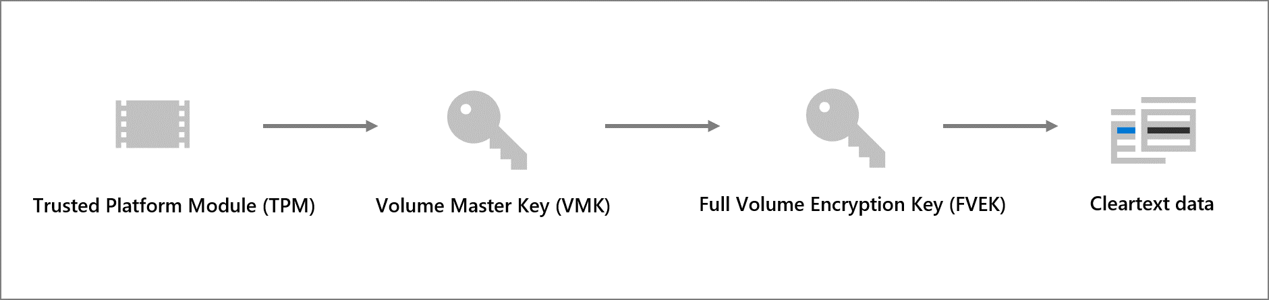
Learn how Bitlocker Encrypts Data-at-rest

Slide 35
Service encryption in Microsoft Purview
Available encryption options:
Service Encryption, Azure RMS, and S/MIME
Service Encryption, optionally with Customer Key
Encryption of all data saved in a Microsoft 365 tenant.
Information Rights Management (IRM) with Rights Management Service (Azure RMS)
Protection of individual documents, files and emails.
Secure/Multipurpose Internet Mail Extensions (S/MIME):
Encryption and digital signing of email messages and attachments only.
Encryption Key Management:
Service Encryption – Microsoft managed Keys or Customer Keys
Azure RMS – Microsoft managed Keys, BYOK, DKE, or HYOK

Slide 36
Implement Keys for Service Encryption
Service Encryption
Configured via Azure Key Vault (AKV) and Data Encryption Policies (DEP)
DEPs associate customer keys from AKVs with mailboxes or services
Exchange Online: 50 DEPs per tenant
SharePoint Online: One DEP per geo location or tenant
Note: Activation of Service Encryption requires intervention of the Microsoft support.
Notes:
Use this slide if you would like to go deeper into implementing keys for service encryption.

Slide 37
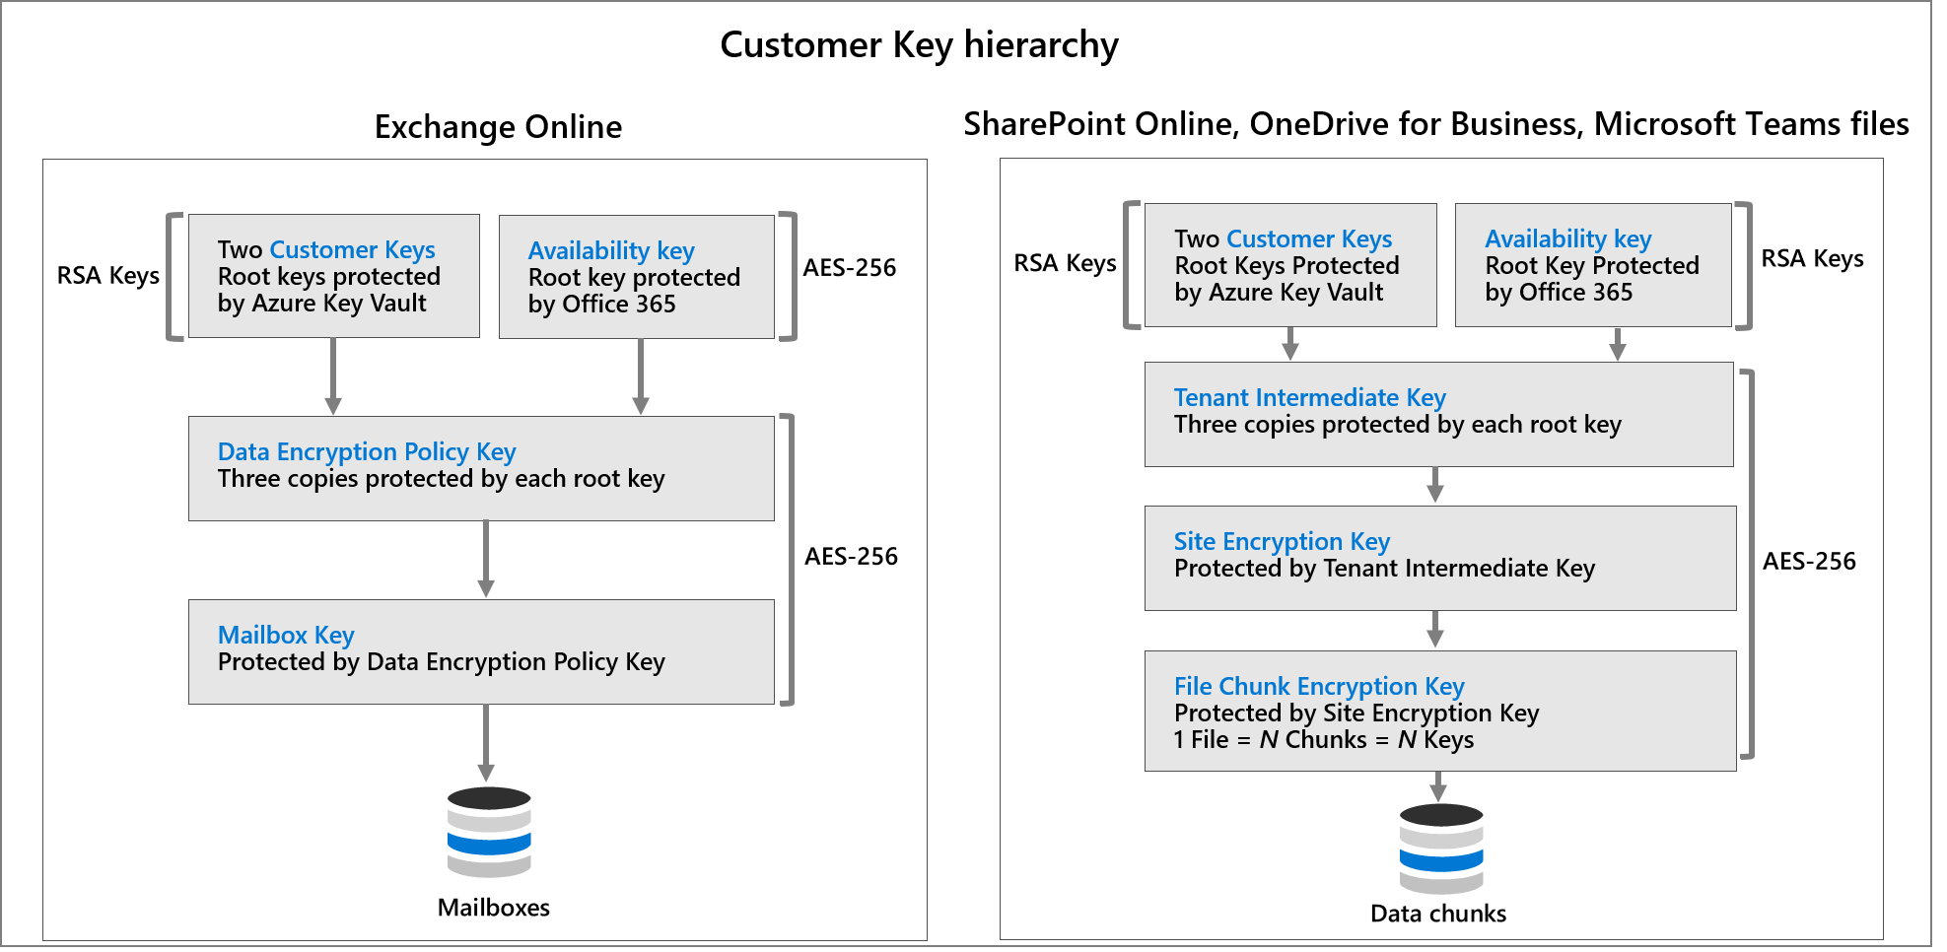
Customer Key management using Customer Key
Notes:
Supporting videos for instructor or student use:
Demonstration: Office 365 Data at Rest encryption
https://www.microsoft.com/videoplayer/embed/RE4yvH4
(3 minutes)

Slide 38
Encrypted data in transit
Data-in-transit scenarios include:
When a client machine communicates with a Microsoft server.
When a Microsoft server communicates with another Microsoft server.
When a Microsoft server communicates with a non-Microsoft server (for example, Exchange Online delivering email to a third-party email server).
Notes:
Inter-datacenter communications between Microsoft servers take place using TLS or IPsec, and all customer-facing servers negotiate a secure session using TLS with client machines.
Microsoft owns and manages its own certificate authority to manage the certificates used for TLS encryption and utilizes third party solutions such as DigiCert and GlobalSign.

Slide 39
Deploy message encryption in Microsoft Purview

Slide 40
Agenda: Deploy message encryption in Microsoft Purview
Configure Microsoft Purview Message Encryption for end users.
Implement Microsoft Purview Advanced Message Encryption.

Slide 41
Implement Microsoft Purview Message Encryption
Microsoft Purview Message Encryption uses IRM and RMS templates
Default configuration
Branding templates
Default configuration named “OME Configuration” is available
Modifications apply to all users
Customization of the Outlook, OME portal, and functionality is possible
Only one branding template is available for all with basic OME
Notes:
Supporting videos for instructor or student use:
Office 365 Essentials: Office Message Encryption
https://www.youtube.com/watch?v=CQR0cG_iEUc&t=13s
(4:30 video)

Slide 42
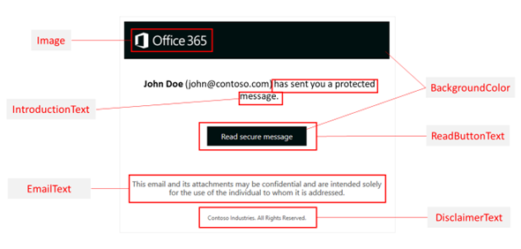
Implement Microsoft Purview Advanced Message Encryption
Additional Features
Multiple branding templates
Message Expiration added (1 – 730 days)
Customized templates for different groups of users

Slide 43
Use Message Encryption Templates in Mail Flow Rules
Configuration via Mail Flow Rules
Different OME configurations are assigned via mail flow rules
Possible use cases:
Individual departments.
Different products.
Different geographical regions.
Determine whether emails can be revoked.
Determine whether emails sent to externals expire after several days.

Slide 44
Protect information in Microsoft Purview

Slide 45
Agenda: Protect information in Microsoft Purview
Discuss the information protection solution and its benefits.
List the customer scenarios the information protection solution addresses.
Describe the information protection configuration process.
Explain what users will experience when the solution is implemented.
Articulate deployment and adoption best practices.

Slide 46
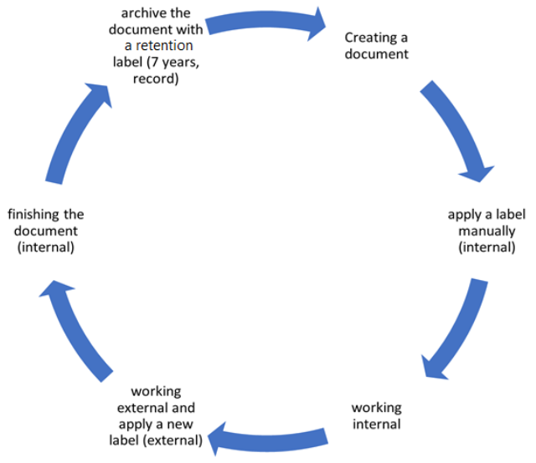
Basics of sensitivity labels
Sensitivity Labels are a solution to handle the lifecycle of company data with classify, encryption, and access management in Microsoft 365.
Sensitivity Labels move with a labeled document and can be applied to locations such as SharePoint sites, Microsoft 365 groups, documents, and e-mails or may be applied to Azure Purview assets.

Slide 47
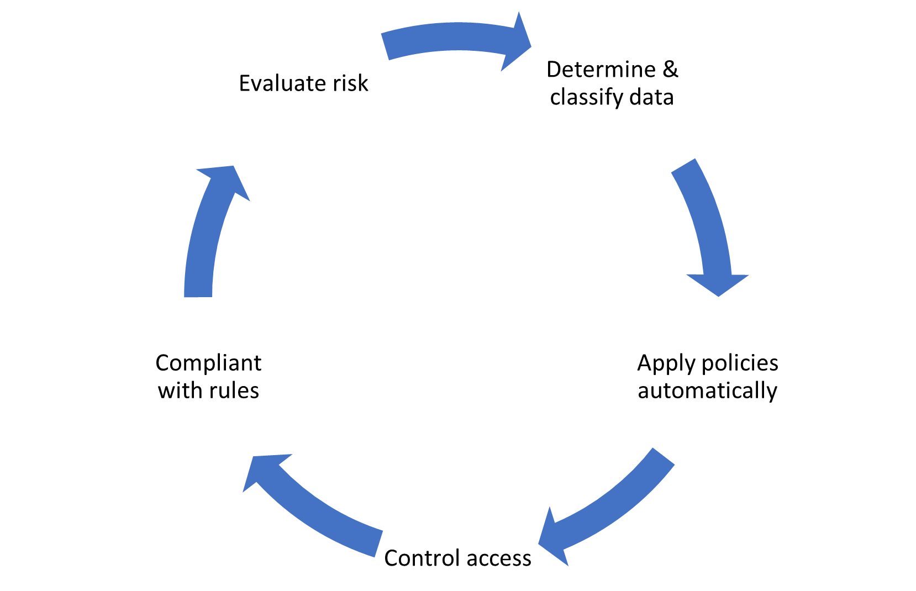
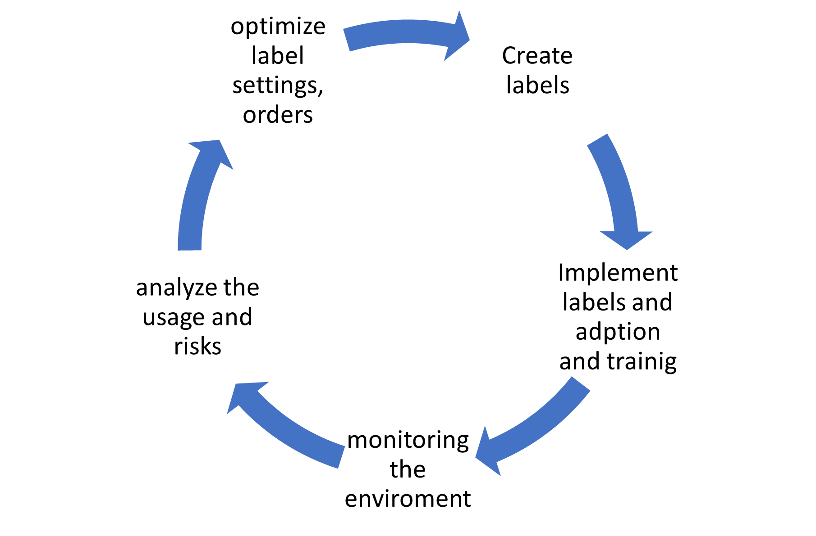
Administer the sensitivity labeling lifecycle
The lifecycle of the sensitivity labeling for the administrator:
The lifecycle of the sensitivity label:
Notes:
Use this slide if you would like to talk more about sensitivity label lifecycle.

Slide 48
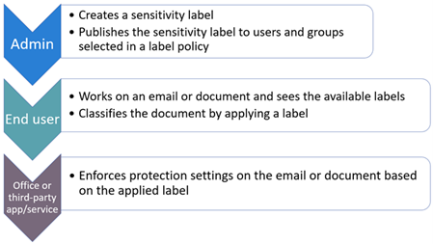
Configure sensitivity labels
Sensitivity labels can be created by an admin through either the Purview portal UI or PowerShell.
Select a scope of either Files & emails, Group & sites or Azure Purview assets.
Items can be auto-labeled on either Sensitive info types or trainable classifiers.
PowerShell provides additional options for multilanguage support.

Slide 49
Configure sensitivity label polices
Sensitivity labels must be published before they can be applied to items.
Groups must be email enabled like security groups or distribution lists.
Microsoft Teams is a use case.
It is a best practice to name the sensitivity label using a naming guideline (like “2021-Jan-HR-HRLabels-RK”).

Slide 50
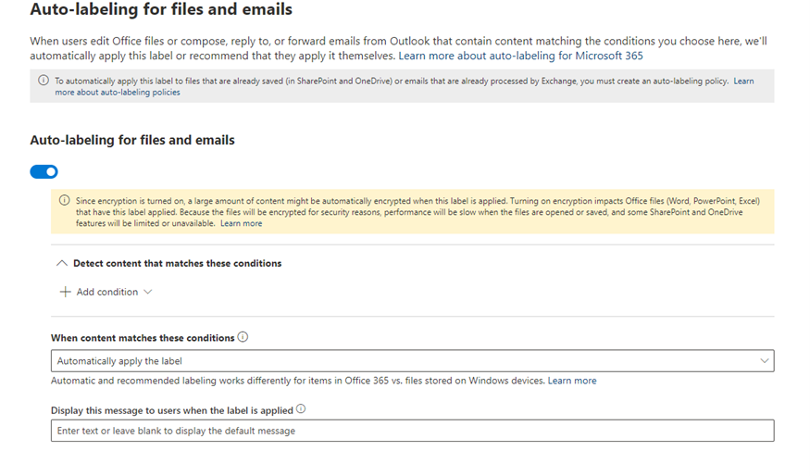
Configure auto-labeling policies
The Microsoft Purview portal includes options to configure and publish auto-labeling policies.
The option is provided through the create a label wizard and allows the label to be automatically assigned based conditions set by the administrator.
You can select up to 20 sensitive information types from a list.

Slide 51
Apply and manage sensitivity labels

Slide 52
Agenda: Apply and manage sensitivity labels
Apply sensitivity labels to Microsoft Teams, Microsoft 365 groups, and SharePoint sites.
Monitor label usage using label analytics.
Configure on-premises labeling.
Manage protection settings and marking for applied sensitivity labels.
Apply protections and restrictions to email and files.

Slide 53
Apply sensitivity labels to Microsoft Teams, Microsoft 365 Groups, and SharePoint sites
Labels may be published for use in Microsoft 365 Groups, Microsoft Teams, Yammer communities and SharePoint sites.
You must activate labels in the tenant level via the Azure AD PowerShell module before they can be used.
Sensitivity labels can be manually assigned to SharePoint Sites and Teams sites through the creation settings.
Labels can be changed through the properties of existing SharePoint sites or Microsoft Teams.
A sensitivity label is applied to a Group in the Azure portal through Azure services > Groups > properties.
Notes:
Supporting videos for instructor or student use:
Microsoft Information Protection in SharePoint, OneDrive, and Teams. Part 1: Overview
https://www.youtube.com/watch?v=QDbOkIrt1S4
(19 minute video) may be too long to use in classroom.

Slide 54
Create or extend existing sensitivity labels to Microsoft Purview Data Map
Sensitivity labels created before Purview release, don’t include Purview Data Map locations by default.
Extending of labels is required to integrate new Azure Purview source locations.
Afterwards use the Get-PolicyConfig cmdlet to check if “PurviewLabelConsent” is “True”
Labeling for SQL database columns in SQL Server Management Studio (SSMS) has limitations, because Microsoft Purview and labeling in SSMS are separate processes that don't interact with each other.
Use labeling through schematized data assets in Microsoft Purview and not local labeling in SSMS.
Data type | Sources
Automatic labeling for files | Azure Blob Storage Azure Files Azure Data Lake Storage Gen 1 and Gen 2 Amazon S3
Automatic labeling for schematized data assets | SQL server Azure SQL database Azure SQL Database Managed Instance Azure Synapse Analytics workspaces Azure Cosmos Database (SQL API) Azure database for MySQL Azure database for PostgreSQL Azure Data Explorer
Notes:
Supporting videos for instructor or student use:
Microsoft Information Protection in SharePoint, OneDrive, and Teams. Part 1: Overview
https://www.youtube.com/watch?v=QDbOkIrt1S4
(19 minute video) may be too long to use in classroom.

Slide 55
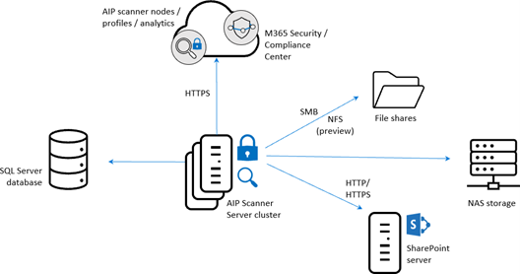
Plan on-premises labeling
The sensitivity labels functionality is natively only available in the user context or in the Microsoft 365 services for auto-labeling
This can be expanded to on-premise through hybrid configuration of the Unified Labeling Scanner.
The Unified Labeling Scanner has the following requirements for setup:
Windows server 2016/2019 with UI
SQL Server 2016 or greater
An Azure AD token
AD Service accounts
Notes:
Supporting videos for instructor or student use:
Discover and protect your on-premises data using Microsoft Information Protection
https://www.youtube.com/watch?v=D8kyAlbstws
(11 minutes)

Slide 56
Configure On-premises Labeling for the Unified Labeling Scanner
The Unified labeling scanner can be used for different operational scenarios, some of them include:
Scan for a report only to know your data: Run the scanner in discovery mode only to create reports that check to see what happens when your files are labeled.
Run the scanner to find and discover files with sensitive information: Run the scanner to discover files with sensitive information, without configuring labels that apply automatic classification.
Run and apply labels: Run the scanner automatically to apply labels as configured.
Specific scan only a few files types: Define a file types list to specify specific files to scan or to exclude.
Notes:
Instructor note:
More details on the unified labeling scanner:
Install and configure the Azure Information Protection (AIP) unified labeling scanner | Microsoft Docs

Slide 57
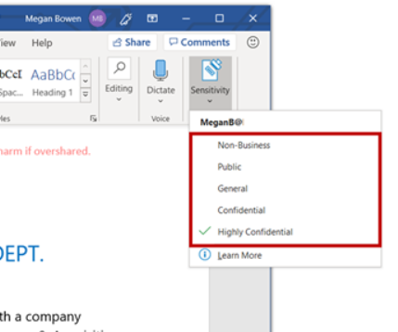
Apply protections and restrictions to email and files
It is important to apply a sensitivity label to an email as well as the contained files.
The email is only the container of the files with it´s own separate protection configuration for the attachments.
You can apply a sensitivity label to an email manually in the Outlook Desktop app. Create an email and before sending the email an option is available in the ribbon menu to assign a sensitivity label.
You can create a default sensitivity label for both the documents and emails using auto-apply publishing through the Compliance center.

Slide 58
Apply protections and restrictions to email and files (Continued)
It’s possible to apply a sensitivity label to a file through the following options:
Unified Labeling Client (Windows, Mac), Native Office Desktop Apps (limited), Mobile Office Apps (iOS, Android)
You can:
Choose a label for external and internal sharing
Assign a label without a Microsoft Office client
Apply a default sensitivity label to a SharePoint document library
Set a default label via sensitive information
Apply sensitivity labels with Microsoft Defender for Cloud Apps

Slide 59
Monitor label performance using label analytics
The sensitivity labels reports are available in the Microsoft Purview portal
The Label analytics tool is provided through the Azure Portal and requires an Azure subscription.
Monitoring and analysis is also available through Microsoft Sentinel.
Notes:
Microsoft Azure Sentinel is a scalable, cloud-native, security information event management (SIEM) and security orchestration automated response (SOAR) solution.

Slide 60
Knowledge check
1
Which of the following define what to do with data that has been classified?
Sensitive information types
Labels
Policies
2
Which of the following items enables you to prevent unintended sharing of documents created from official company templates?
Keyword dictionary
Document fingerprinting
Proximity indicators
3
If you want to restrict access to a file, you need to configure a sensitivity label with which of the following?
Marking content
Encryption
Guest access

Slide 61
Lab – Implement Information Protection

Slide 62
Lab Exercises
Exercise 1: Manage Compliance Roles
Exercise 2: Manage Microsoft Purview message encryption
Exercise 3: Manage sensitive information types
Exercise 4: Manage trainable classifiers
Exercise 5: Manage sensitivity labels

Slide 63
Closing slide

